Slide 1

Max’s PC Shop
Video Demo 3

Slide 2
Update
Majority of the rest of the work for my website consists of: adding more items to the shop, fixing minor issues, and tweaking some elements/styles. This applies to the home page as well.
Completely changed the entire websites navigational structure and I feel as though it is much more simpler and easier to navigate compared to the other version before.

Slide 3
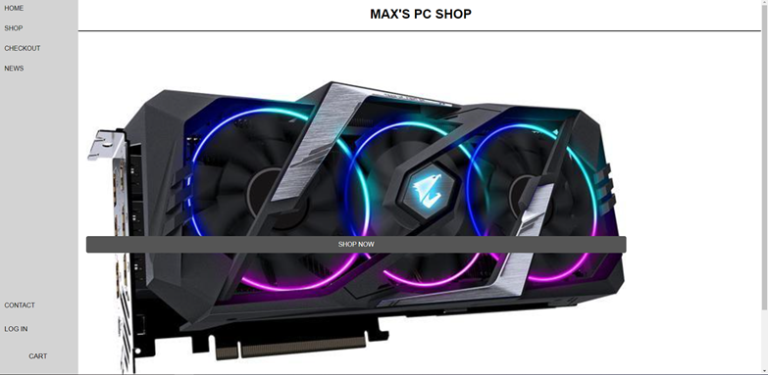
HOME PAGE
I wanted to keep the home page simple with a simple image and button to get directly to the shop. The button and image are placeholders for right now.
I may add a rotating image slideshow type thing instead of just one single image

Slide 4
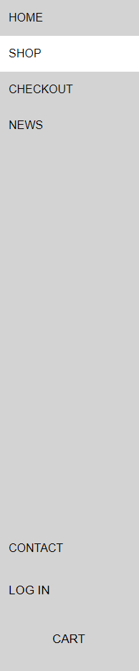
NAV
I completely changed the entire structure of my website since the last video demo as I didn’t like it and I am a real big fan of side navigation links.
I added the CONTACT, LOG IN, and CART hyperlinks to the bottom of the screen as I see that is what a lot of website tend to do.

Slide 5
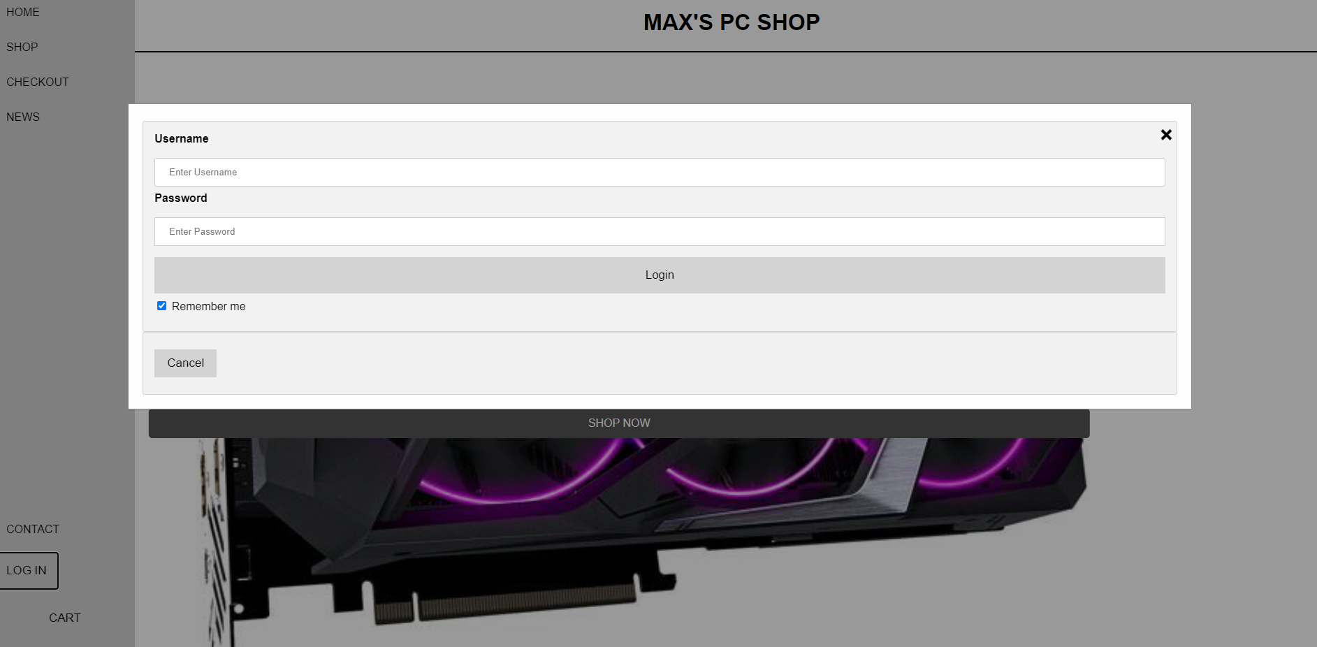
NAV (LOG IN)
I wanted to add a place where customers could log in to the store just like most online stores have where they offer their customers rewards and such.
I created this effect you with HTML and JavaScript.
This was just a different way of giving the information to the customers than just the standard click and go to a completely new screen.
There is a sort of fade transition to it as well.

Slide 6
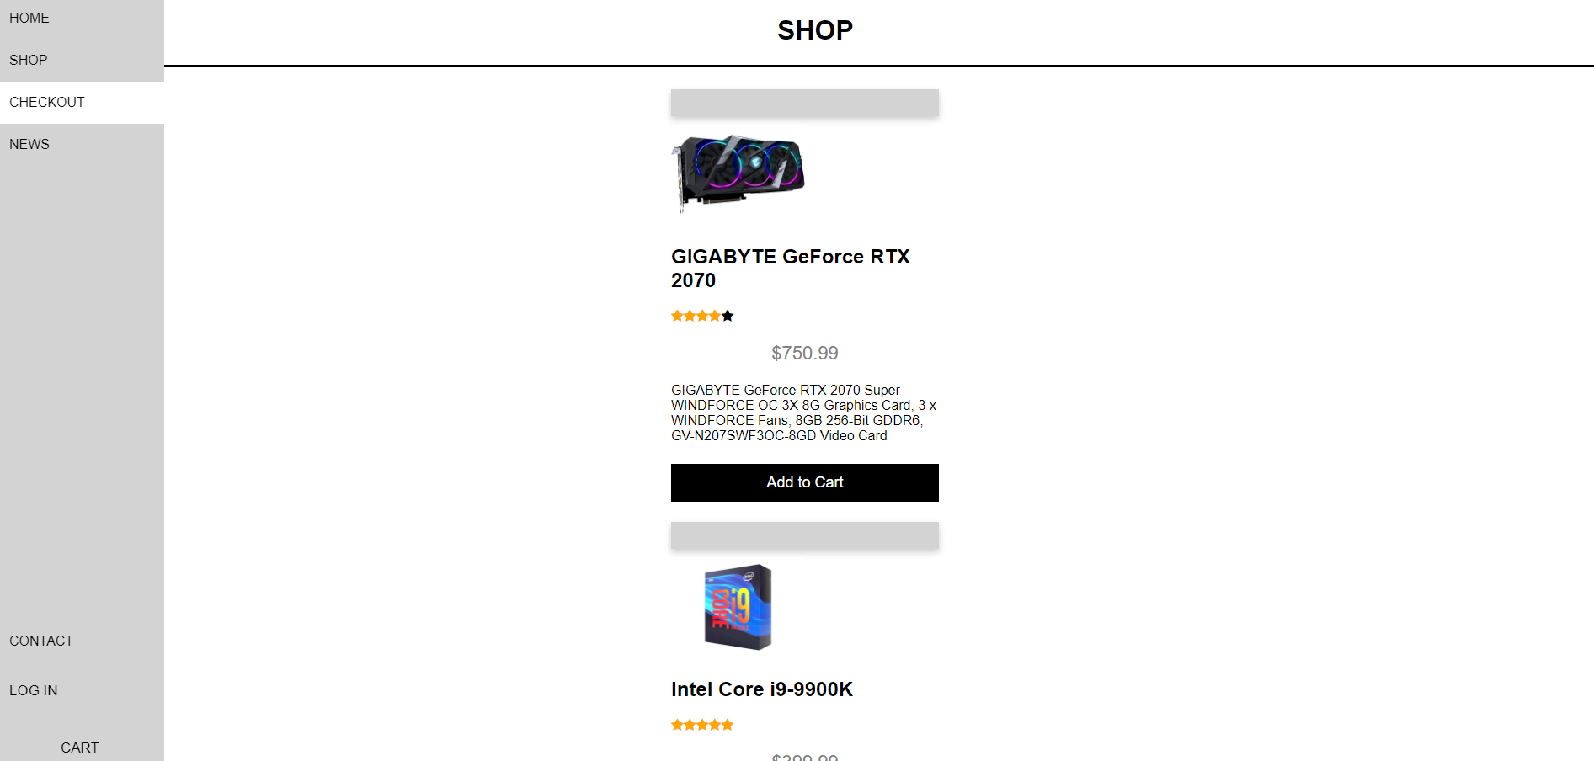
SHOP
This the shop page and not much has changed except a few minor details which you probably can’t even tell.
I am adding more and more items to the shop every week and I am wanting each item to have a ‘quick view’ button under the product description but above the ‘Add to Cart’ button to create a similar pop out window with a more detailed description (size, weight, etc.)
I have a total of 16 products and want to have at least double that by the end of next week

Slide 7
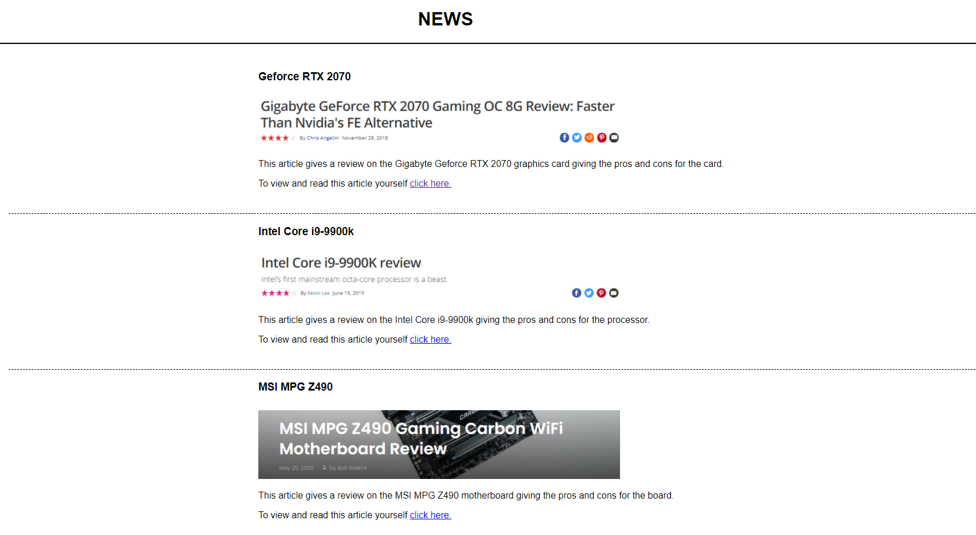
NEWS
I have slowly been adding a few articles from reputable sources in the industry.
Each article has a brief description with a picture and hyperlink that can guide the reader to a more detailed description of the product they are looking for.
In total I have 6 articles and plan to have 10 by the final website

Slide 8
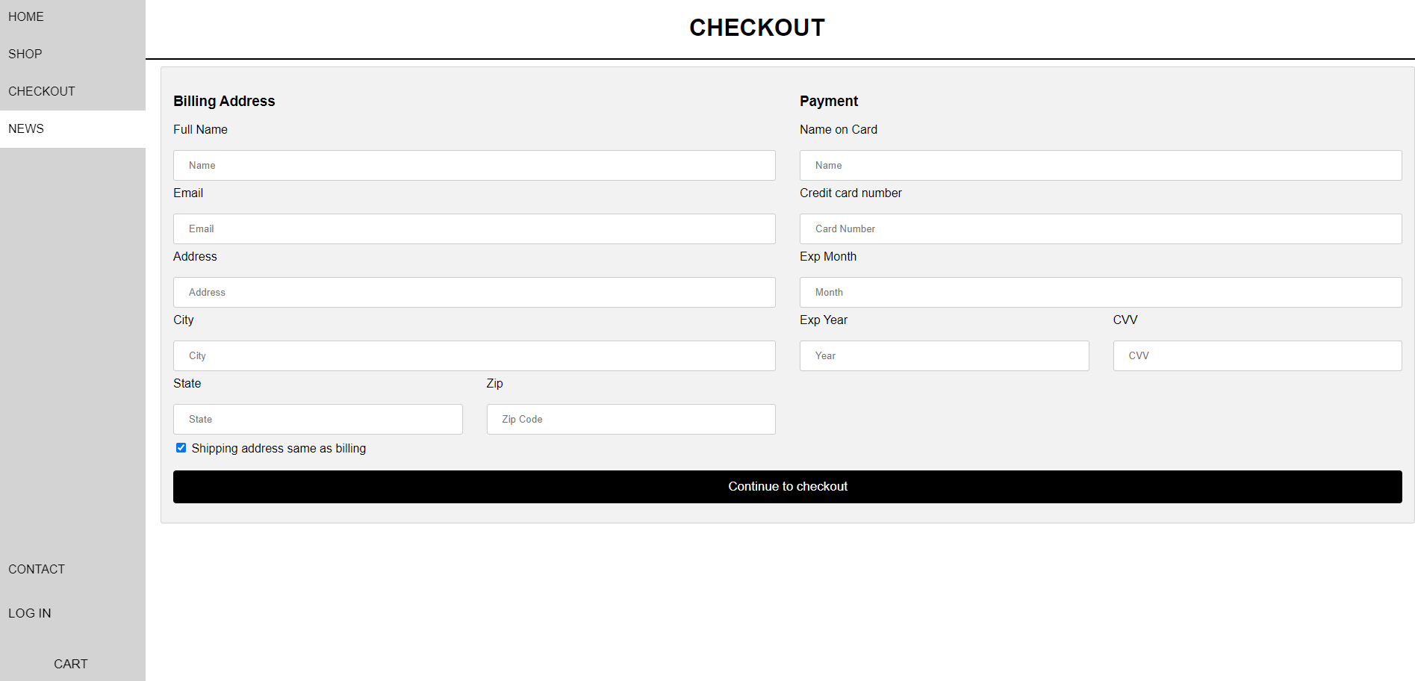
CHECKOUT
Simple checkout form

Slide 9
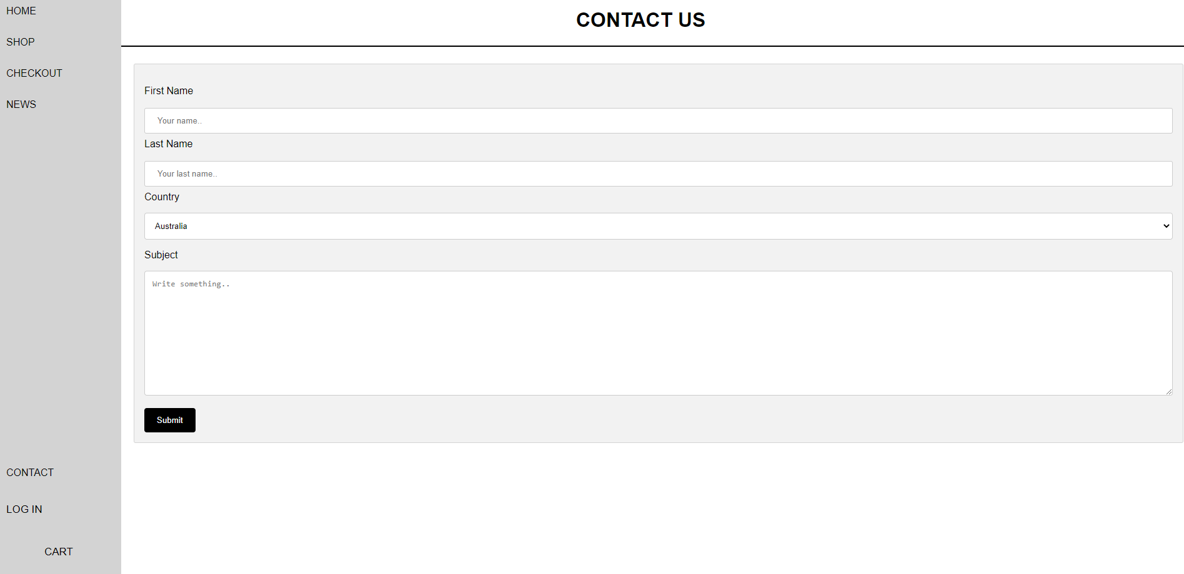
CONTACT
Simple contact form where customers can send us questions that they may have about a certain product

Slide 10
Thanks for watching!

